Slide 1
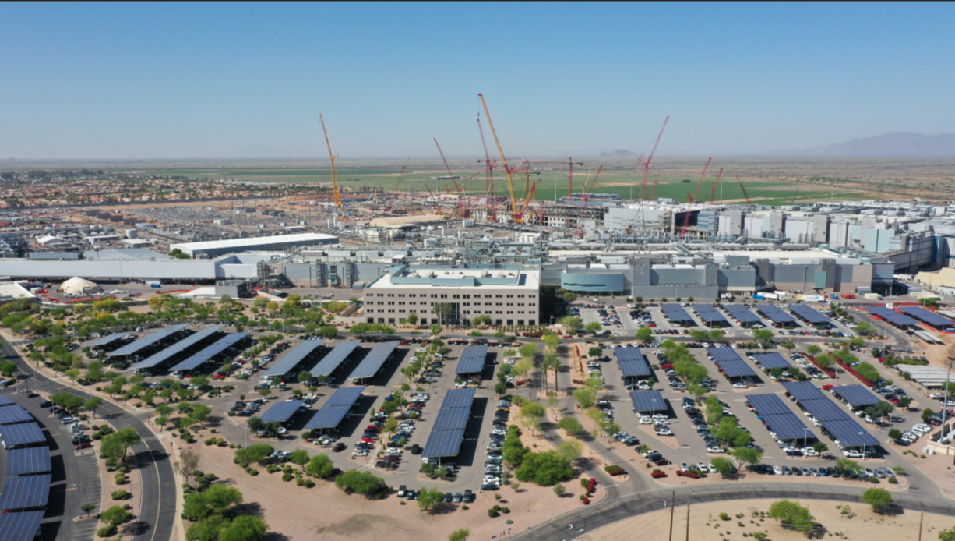
40+ Years Invested in Arizona
$32 B Invested, $20 B Additional In Progress, $8.6 B Annual GDP
12,000 Direct Employees, 55,000 Total Jobs Supported

Slide 2
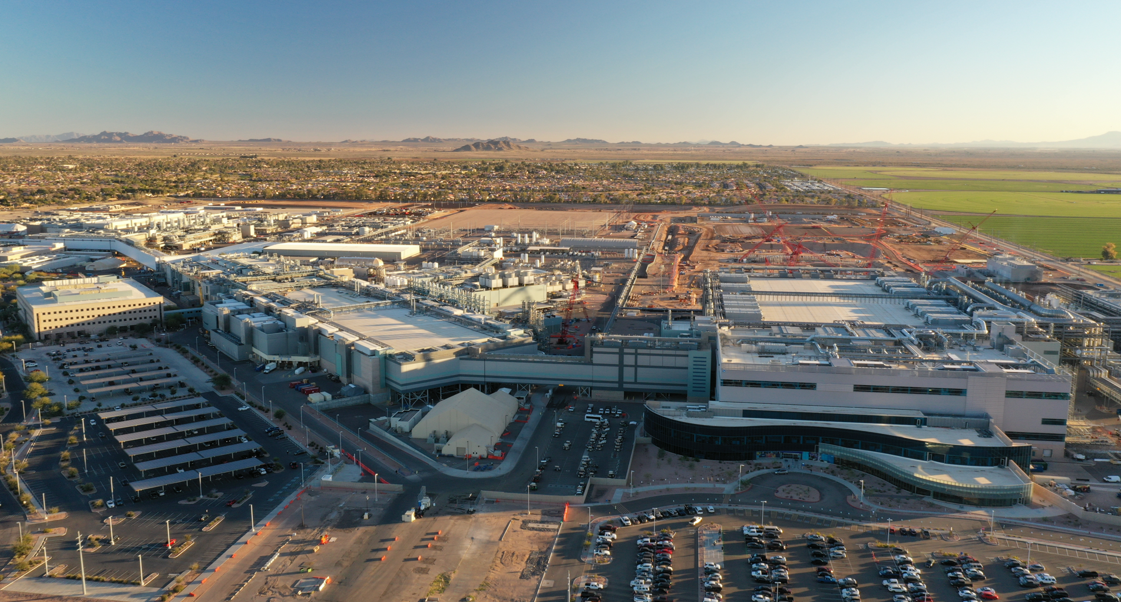
Welcome to the Intel Ocotillo Campus

